Slide 1
EECT 121 Lab Notebook
Cody Fletcher

Slide 2
Table of Contents
Lab 1: Diode
Lab 2: Full Wave Bridge
Lab 3: LED
Lab 4: ± 9v Power Supply
Lab 5: NPN LED Switch
Lab 6: CE Transistor Amp
Lab 7: NPN LED Switch (2n5457)
Lab 8: CE Transistor Amp (2n5457)
Lab 9: Butterworth Low Pass Filter
Lab 10: Butterworth High Pass Filter
Lab 11: Bandpass MPF
Lab 12: Notch Filter

Slide 3
Lab 1: Diode

Slide 4
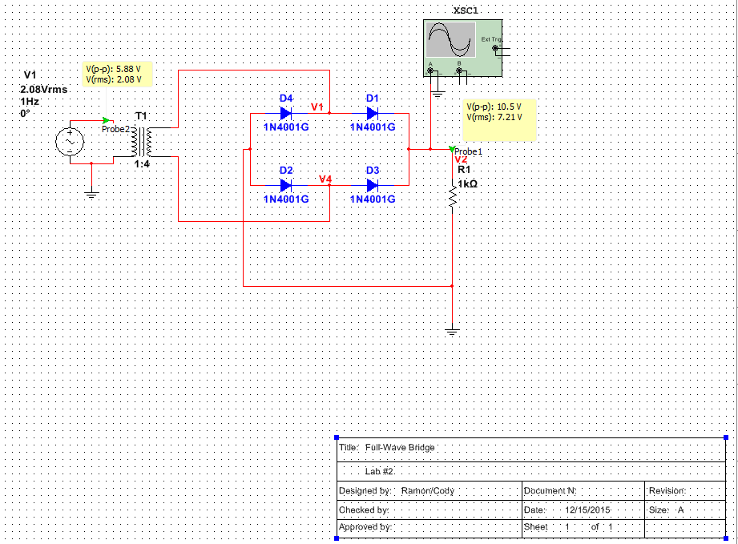
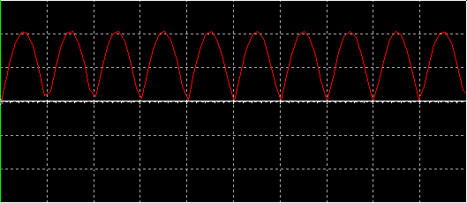
Lab 2: Full Wave Bridge
1N4001 Data Sheet

Slide 5
Lab 3: LED

Slide 6
Lab 4: ± 9v Power Supply
Requirements
Build a power supply that produces ±9V DC, ±5% tolerance.
Maximum current 100mV
120V AC input
Maximum start up time 100ms
Must contain a Fuse
Maximum cost $25.00

Slide 7
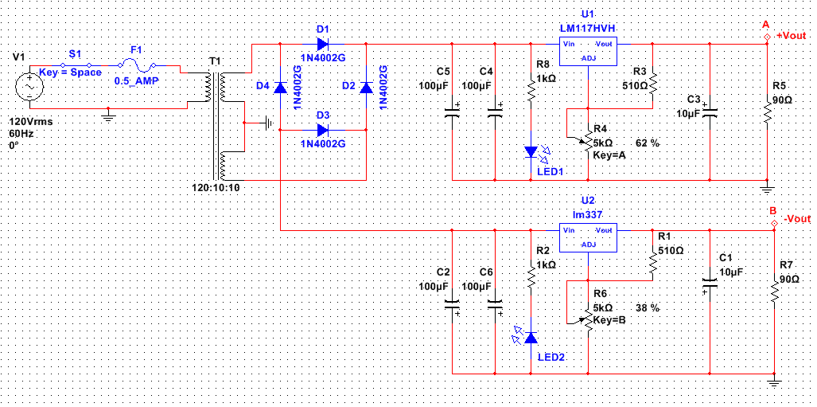
Lab 4: ± 9v Power Supply
Schematic

Slide 8
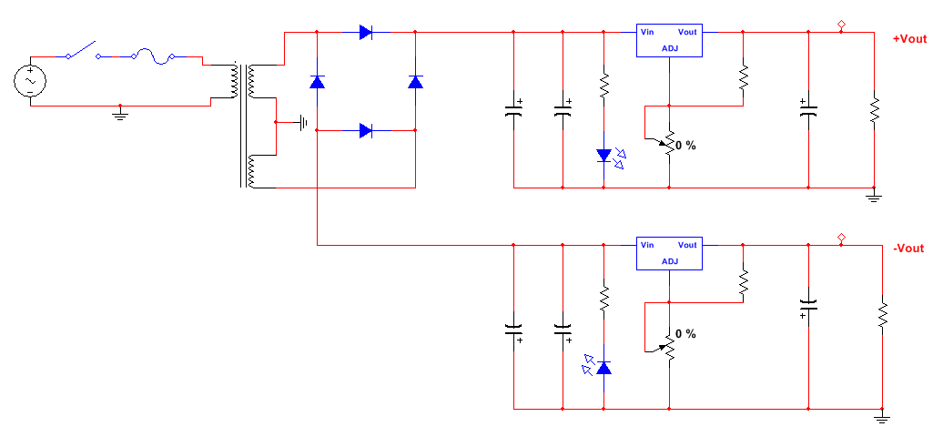
Lab 4: ± 9v Power Supply
Bill of Material
1
11/12
8
ITEM # | PART # | PART NAME | QUANTITY | UNIT PRICE | TOTAL
1 | 17SWTOGWR | Toggle Switch | 1 | $ 0.95 | $ 0.95
2 | 16P112-1 | 12.6VCT tranformer | 1 | $ 6.50 | $ 6.50
3 | 14EA050100U | 100uf Cap | 4 | $ 0.60 | $ 2.40
4 | 14EA05010U | 10uf Cap | 2 | $ 0.22 | $ 0.44
5 | 130051K | 1k Ω resistor | 2 | $ 0.06 | $ 0.12
6 | 13015510 | 510 Ω resistor | 2 | $ 0.12 | $ 0.24
7 | 18MPT5K | 5k Ω pot | 2 | $ 0.65 | $ 1.30
8 | 10317-T | lm317 voltage reg | 1 | $ 0.35 | $ 0.35
9 | 10337-T | lm337 voltage reg | 1 | $ 0.75 | $ 0.75
10 | 111N4002 | 1N4002 diode | 6 | $ 0.11 | $ 0.66
11 | 2000MDL1/4 | .25amp fuse | 2 | $ 0.90 | $ 1.80
12 | 2001LINL | fuse holder | 1 | $ 0.55 | $ 0.55
13 | 08L53GD | green LED | 1 | $ 0.14 | $ 0.14
14 | 08L53RD | red LED | 1 | $ 0.12 | $ 0.12
SUB TOTAL |  |  |  | $ 12.02 | $ 16.32
10
2
3
5
13
9
7
6
4
14

Slide 9
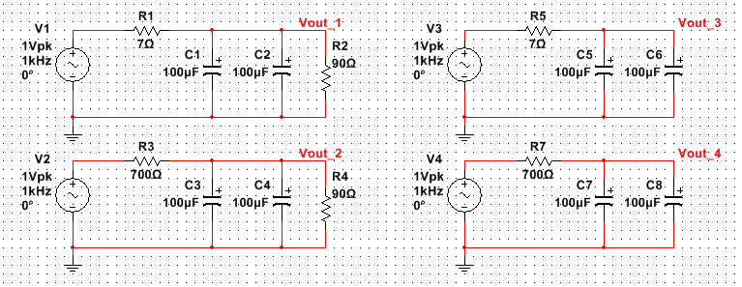
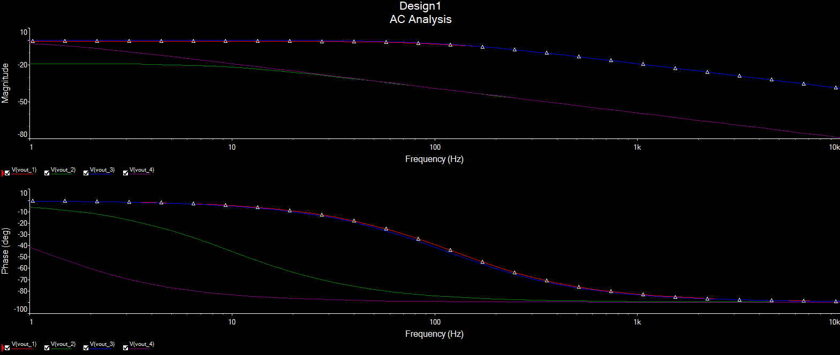
Lab 4: ± 9v Power Supply
Frequency Analysis

Slide 10
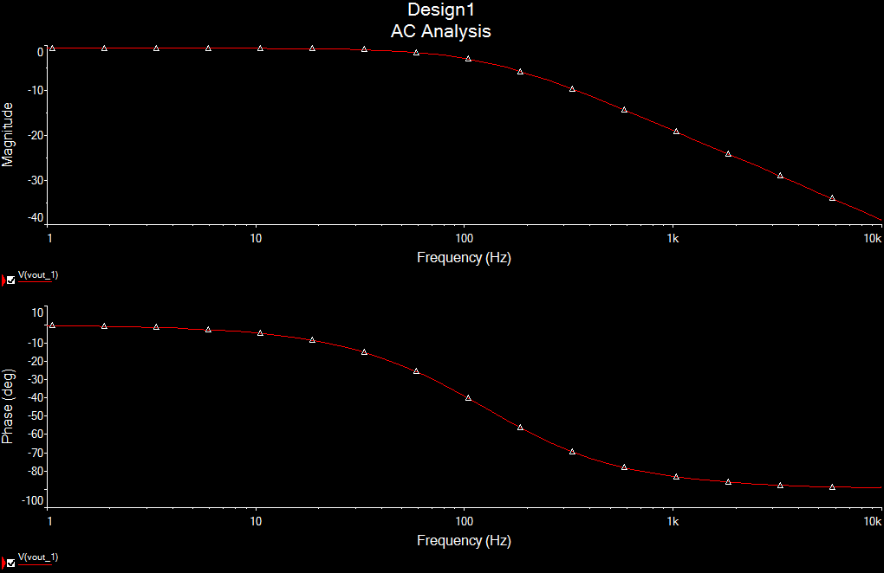
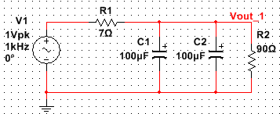
Lab 4: ± 9v Power Supply
Vout 1

Slide 11
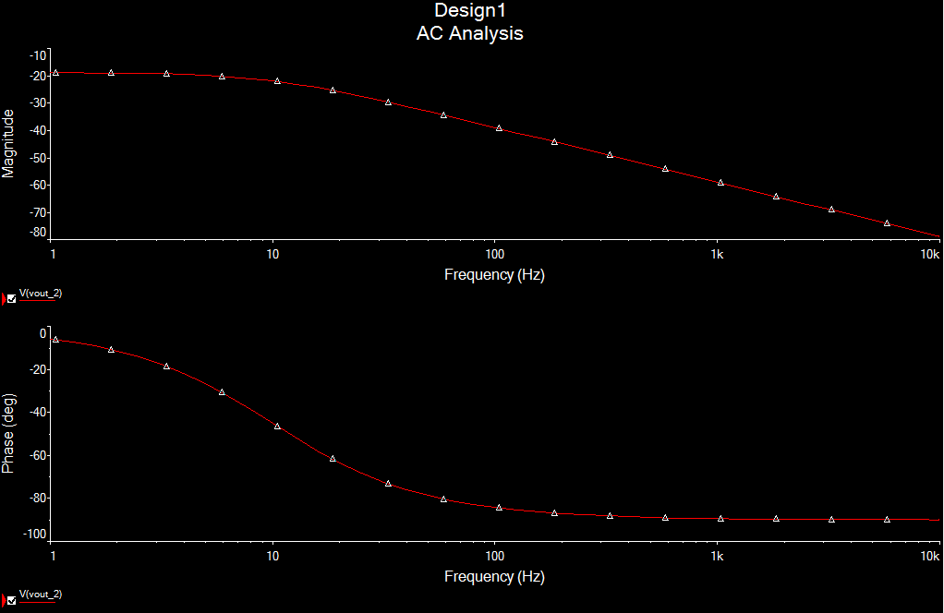
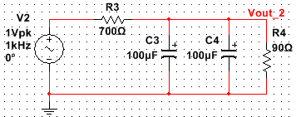
Lab 4: ± 9v Power Supply
Vout 2

Slide 12
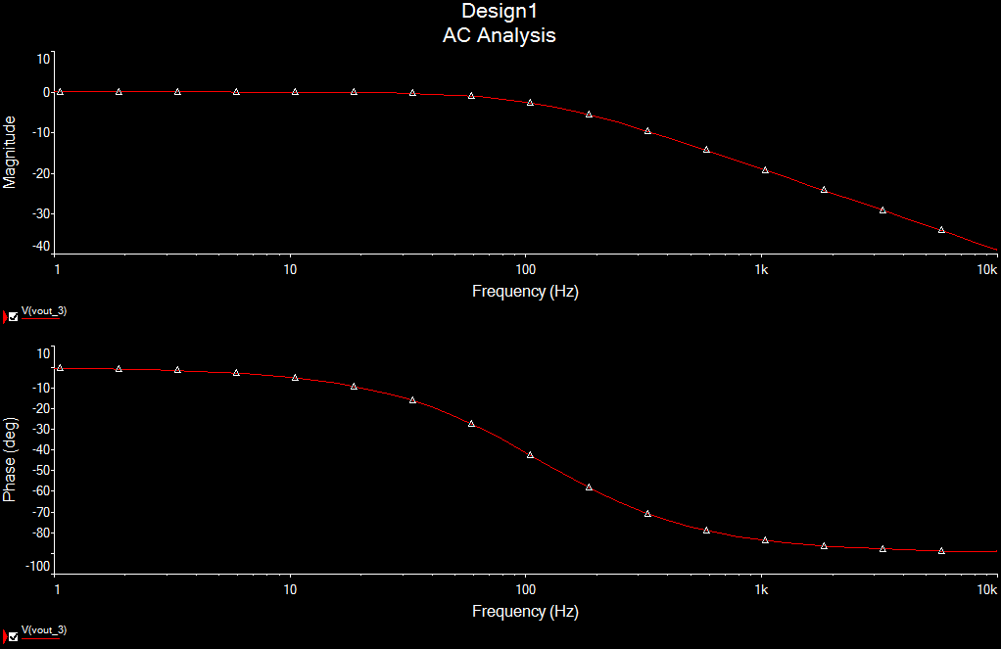
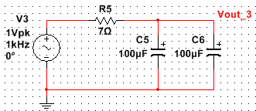
Lab 4: ± 9v Power Supply
Vout 3

Slide 13
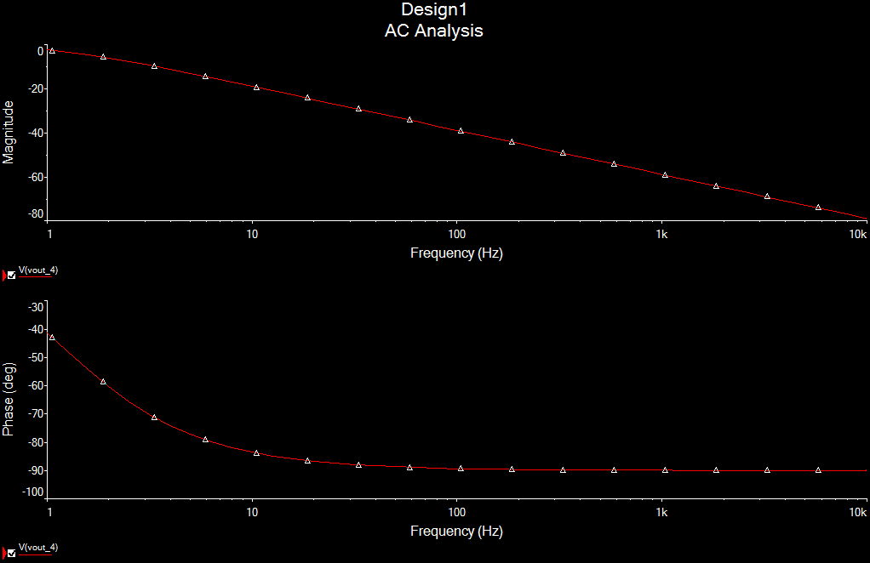
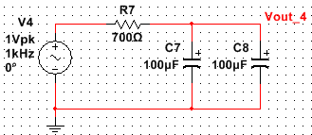
Lab 4: ± 9v Power Supply
Vout 4

Slide 14
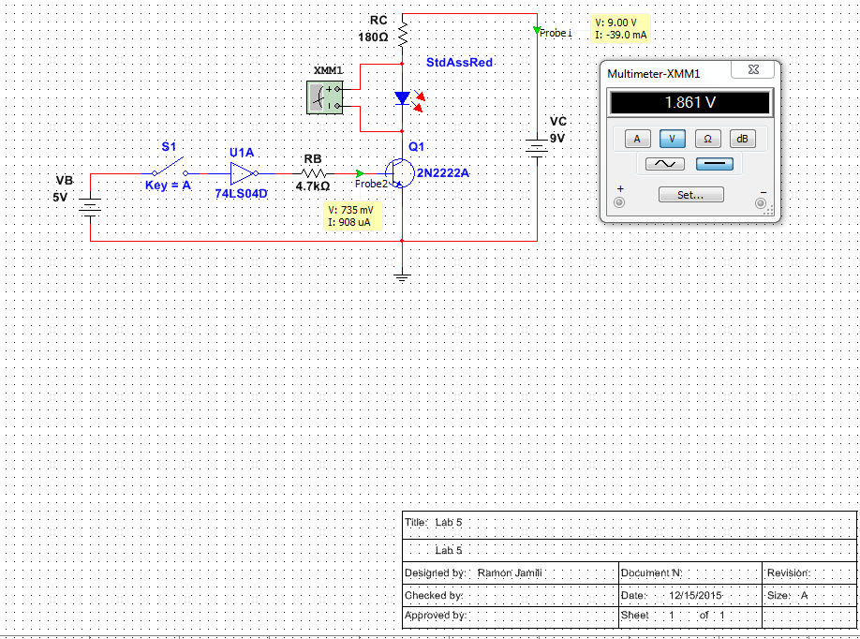
Lab 5: NPN LED Switch
Switch Opened
2N2222 Data Sheet
74LS04 Data Sheet

Slide 15
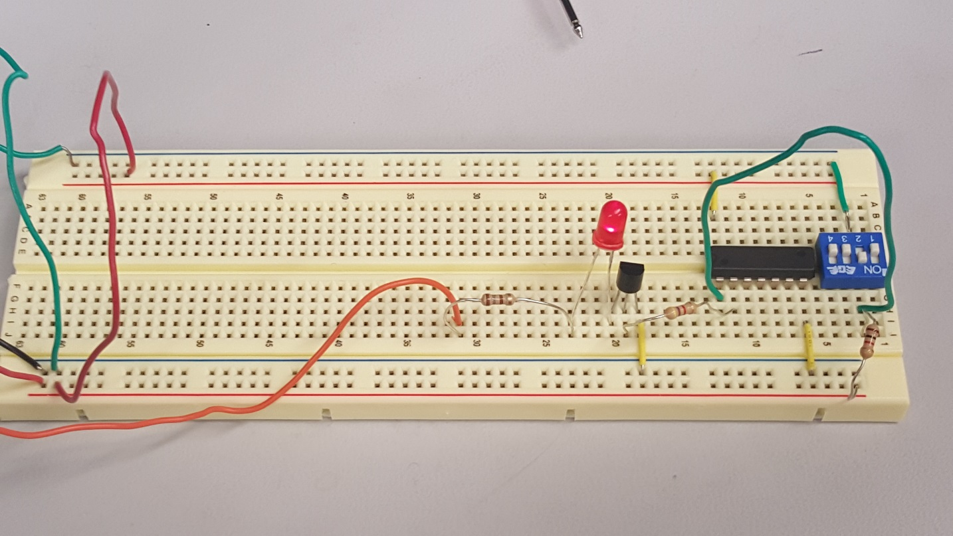
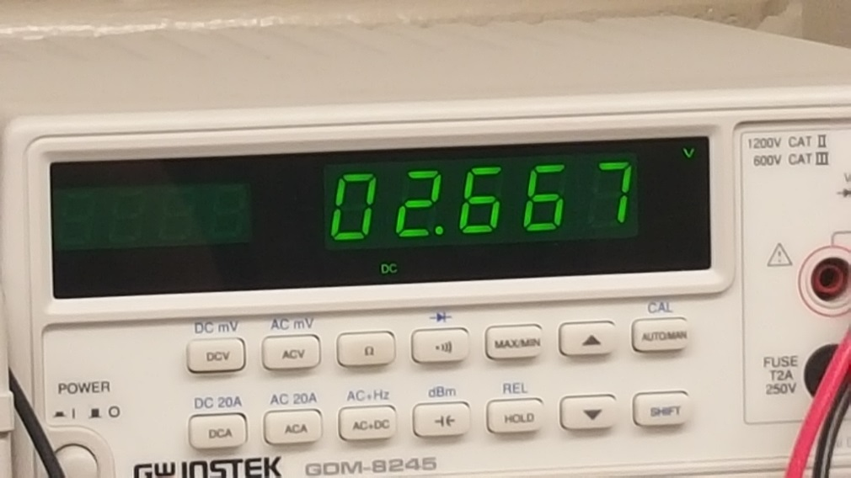
Lab 5: NPN LED Switch
Switch Opened
2N2222 Data Sheet
74LS04 Data Sheet

Slide 16
Lab 5: NPN LED Switch
Switch Closed
2N2222 Data Sheet
74LS04 Data Sheet

Slide 17
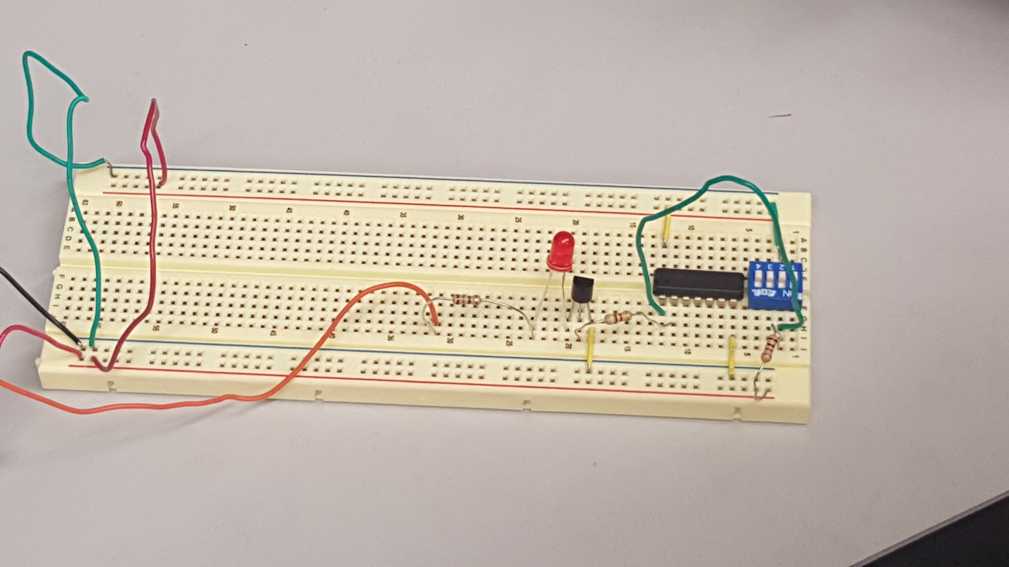
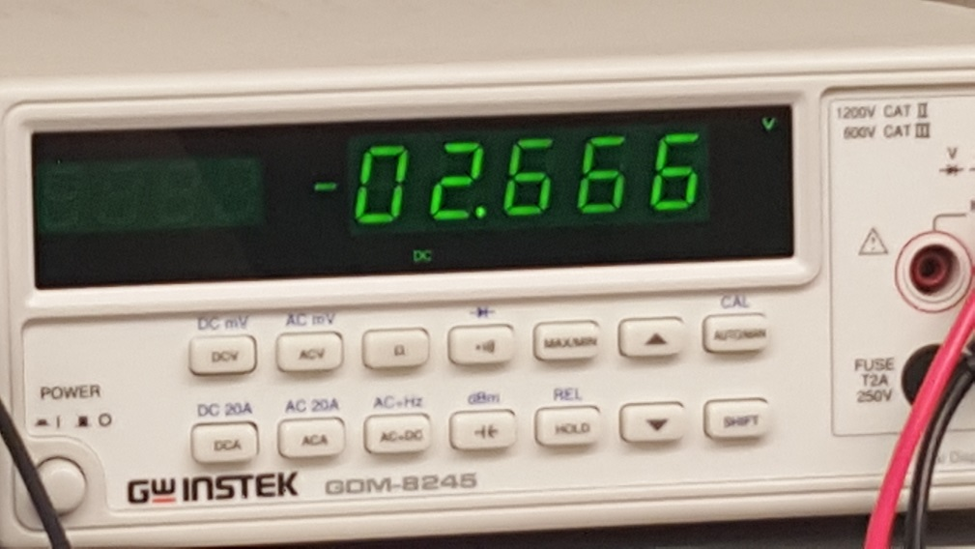
Lab 5: NPN LED Switch
Switch Closed
2N2222 Data Sheet
74LS04 Data Sheet

Slide 18
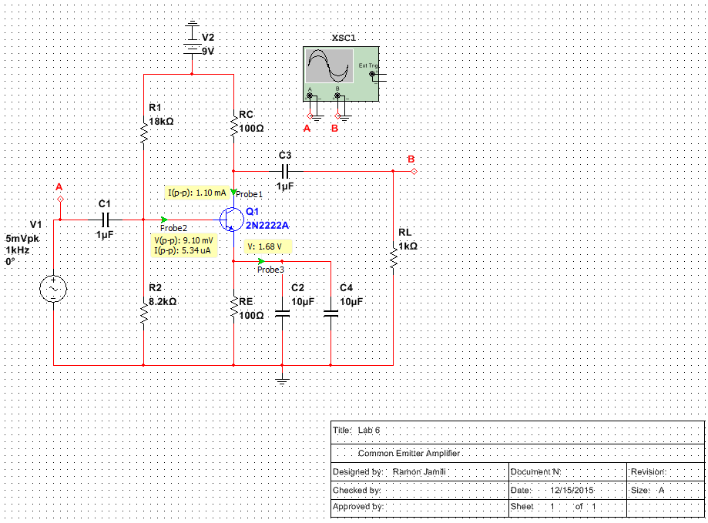
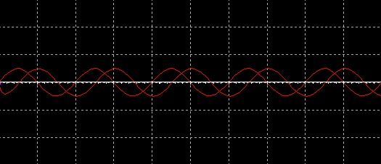
Lab 6: CE Transistor Amp
2N2222 Data Sheet

Slide 19
Lab 6: CE Transistor Amp
2n2222 Characteristic Curve
Link to Spread Sheet

Slide 20
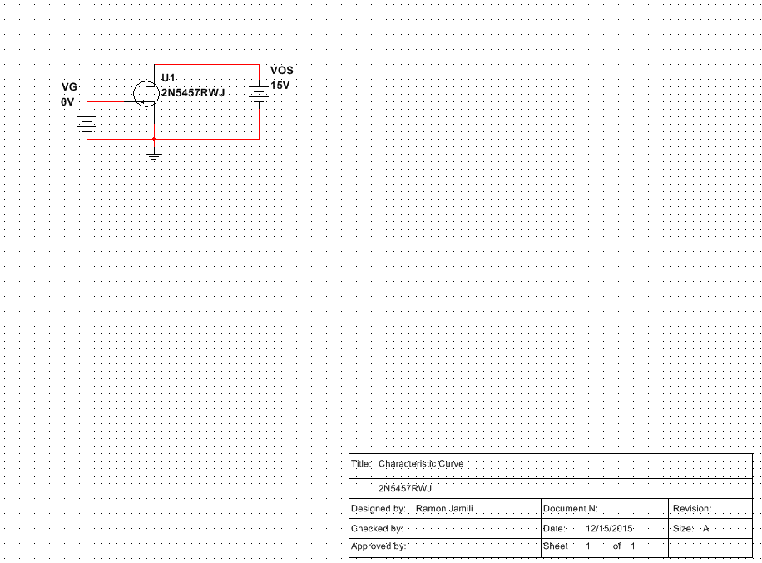
Lab 7: NPN LED Switch (2n5457)
Characteristic Curve
Link to Spread Sheet
2N5457 Data Sheet

Slide 21
Lab 7: NPN LED Switch (2n5457)
Transfer Curve
2N5457 Data Sheet

Slide 22
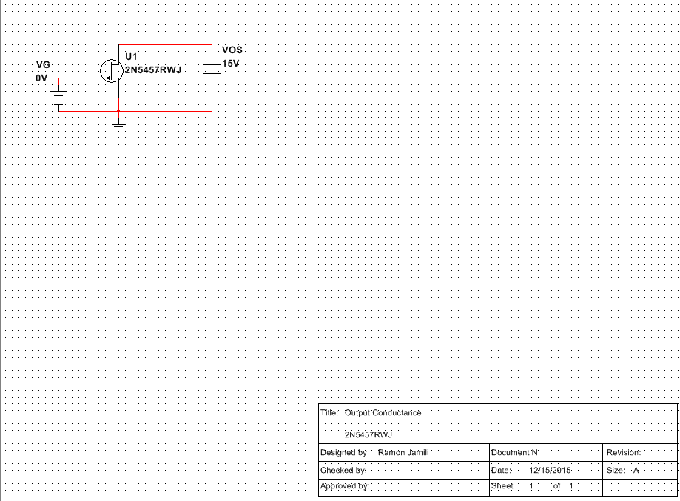
Lab 7: NPN LED Switch (2n5457)
Output Conductance
2N5457 Data Sheet

Slide 23
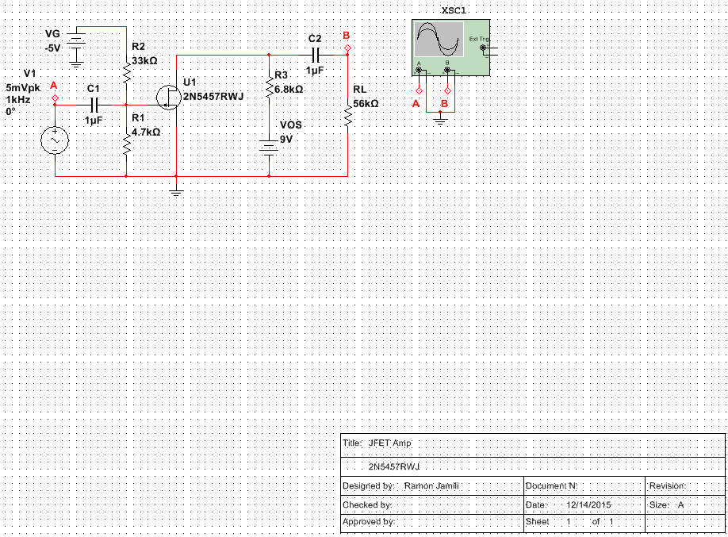
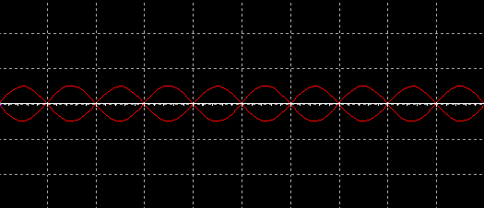
Lab 8: CE Transistor Amp (2n5457)
2N5457 Data Sheet

Slide 24
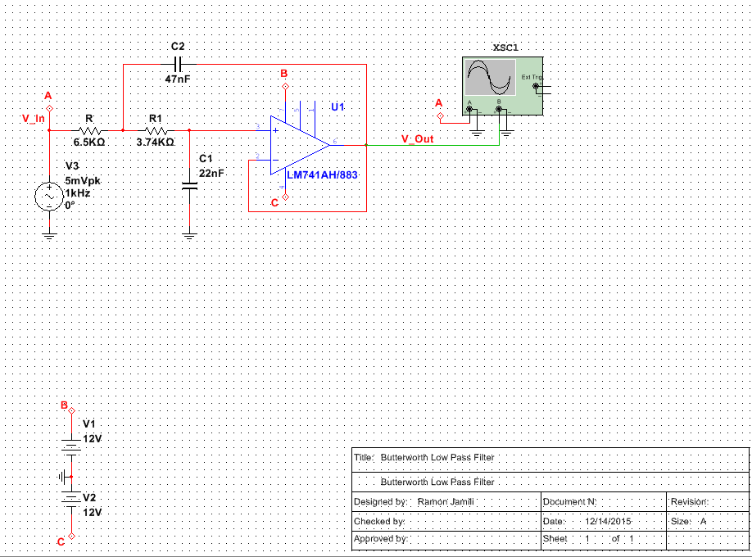
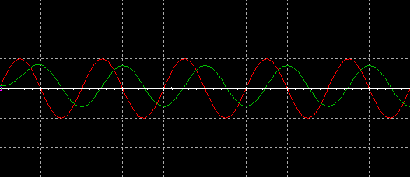
Lab 9: Butterworth Low Pass Filter
LM741 Data Sheet

Slide 25
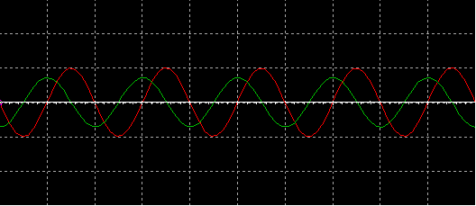
Lab 10: Butterworth High Pass Filter
LM741 Data Sheet

Slide 26
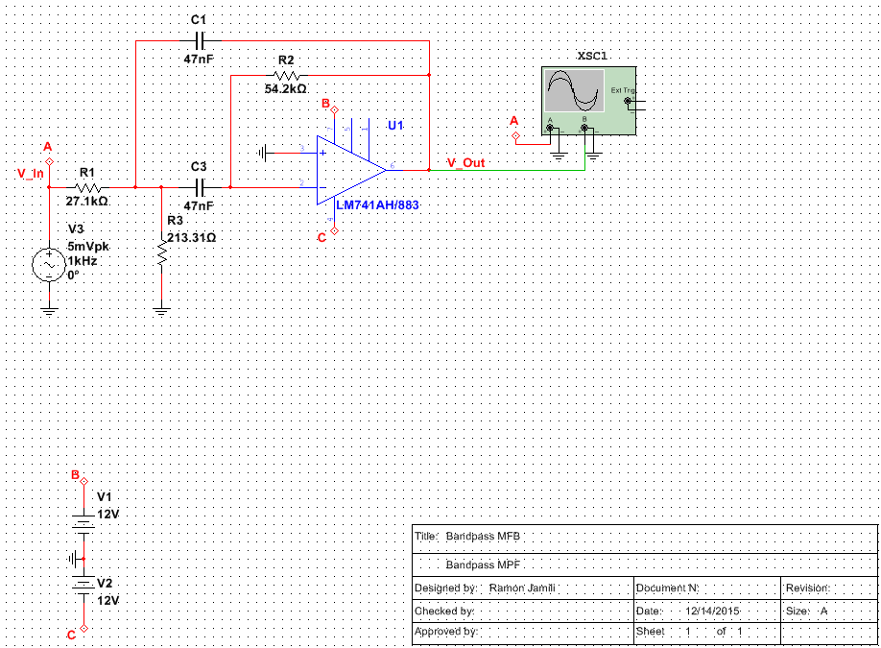
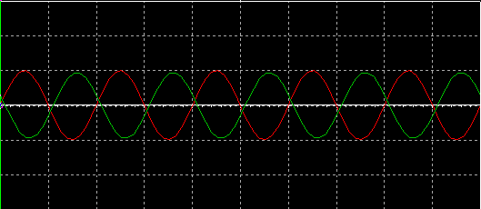
Lab 11: Bandpass MPF
LM741 Data Sheet

Slide 27
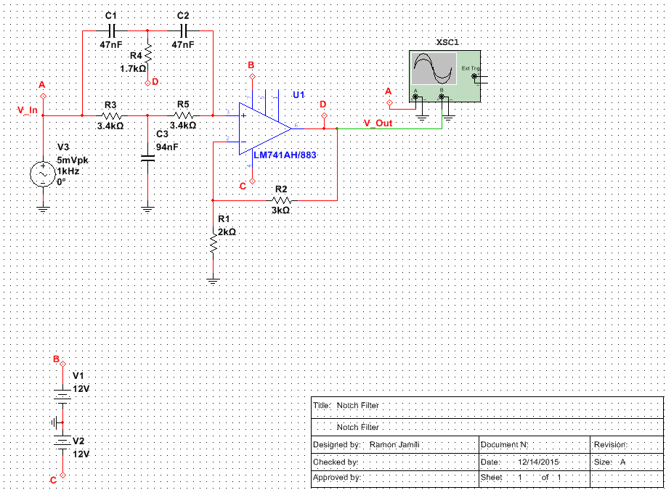
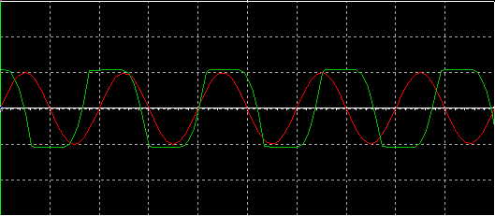
Lab 12: Notch Filter
LM741 Data Sheet

